Slide 1

AI-Powered Multi-Agent Career Acceleration Platform
Instructor: Prof. Hema Seshadri
Semester: Fall 2025
Team Members:
Krati Mudra
Pratham Brahmbhatt
Ansh Jain
Sangayya Rudrayya Hiremath
Zhiwen Sun
Zhuofan Lin

Slide 2

Agenda
Problem Overview
Project Goals
System Architecture
Five AI Agents
Workflow & Demo
Technical Design
Key Results
Impact
Challenges
Future Enhancements
Conclusion

Slide 3
Problem Overview
Resumes get rejected by ATS filters
Job seekers struggle to find the right roles
Tailoring resumes takes time
Interview preparation is inconsistent
Students lack strong project portfolios
The job search process is broken:

Slide 4
Project Motivation
Why we built this:
To automate and simplify the entire career pipeline
To help job seekers transition faster
To offer an AI-driven, structured guidance system
To move from manual to smart automated workflows

Slide 5
Project Goals
Build
Build a modular multi-agent AI system
Automate
Automate resume → job search → interview → portfolio steps
Ensure
Ensure accuracy, personalization, and interoperability
Deliver
Deliver scalable APIs for future expansion

Slide 6
Our Five-Agent Architecture
Resume Analyzer
Job Finder
Resume Tailor
Interview Coach
Project Mentor

Slide 7
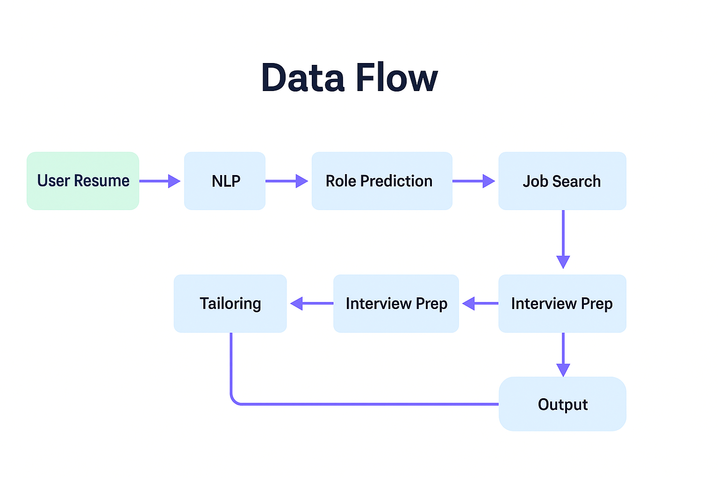
Data Flow Diagram
Input Phase
User uploads resume
NLP extracts text, skills, experience and keywords
Processing Phase
Role prediction model identifies suitable job roles
Job search agent fetches relevant openings
Interview prep agent generates role-based questions
Refinement Phase
Resume tailoring aligns content with selected job description
System prepares final structured output
Final Output
Job list + tailored resume + interview preparation + project ideas

Slide 8
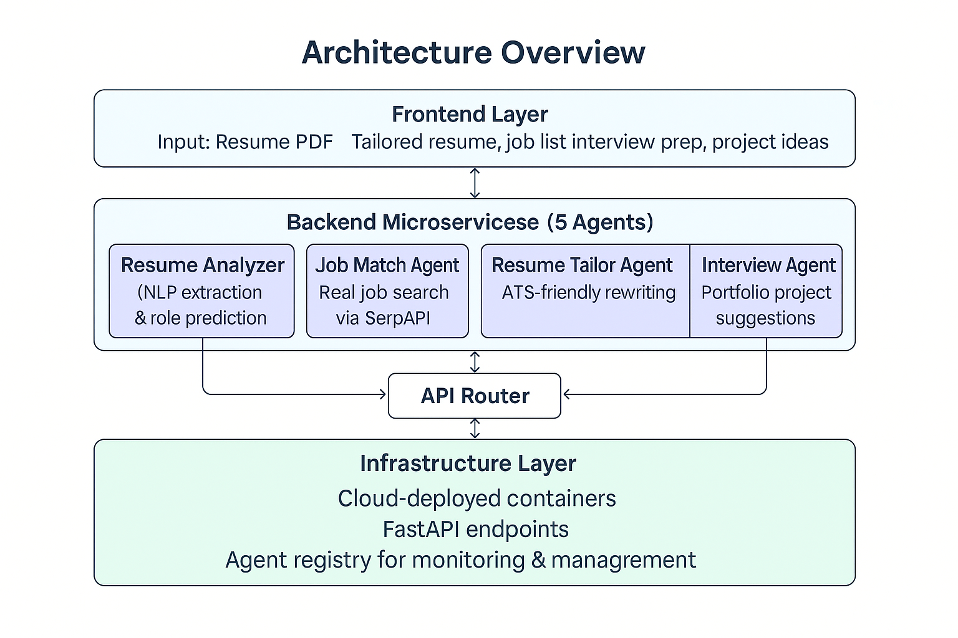
System Architecture Overview
Architecture Layers:
Input Layer: Resume PDF
Processing Layer: NLP extraction & classification
Action Layer: Job search, interview prep, resume tailoring
Output Layer: Tailored resume, job matches, projects

Slide 9

Agent 1: Resume Analyzer
Role: Detects career direction from resume
Functions:
PDF text extraction
Clean preprocessing
NLP-based role prediction
Stores structured profile
Outputs:
Predicted Job Role
Processed Resume Text

Slide 10

Agent 2: Job Finder
Role: Finds real job openings
Functions:
Queries SerpAPI → Google Jobs
Filters by role, location, keywords
Generates structured job cards
Outputs:
Title | Company | Location
Apply link
Description summary

Slide 11

Agent 3: Resume Tailor
Role: Tailors resume for a specific job
Functions:
ATS keyword injection
Rewrite sections (skills, experience)
Produces a clean, customized version
Outputs:
Job-specific optimized resume

Slide 12

Agent 4: Interview Coach
Role: Provides interview readiness
Functions:
Behavioral & technical questions
STAR answers
Company-specific preparation
Warm-up practice scripts
Outputs:
Full interview prep kit

Slide 13

Agent 5: Project Mentor
Role: Builds portfolio direction
Functions:
Suggests 3–5 tailored projects
Includes required tools, data sources
Provides expected outcomes
Helps prepare GitHub readiness
Outputs:
Personalized portfolio roadmap

Slide 14
System Deployment & Agent Registry
Our multi-agent system is fully deployed on a cloud server using containerized microservices.
A centralized Agent Registry Dashboard displays all active agents, their metadata, capabilities, and API endpoints.
Each agent exposes a structured FastAPI interface, enabling real-time testing of resume analysis, job matching, tailoring, interview preparation, and project mentoring.
The deployment ensures modularity, scalability, and independent debugging for each microservice.
The live /docs interface (OpenAPI 3.1) provides interactive testing, making validation and integration seamless for the entire team.

Slide 15
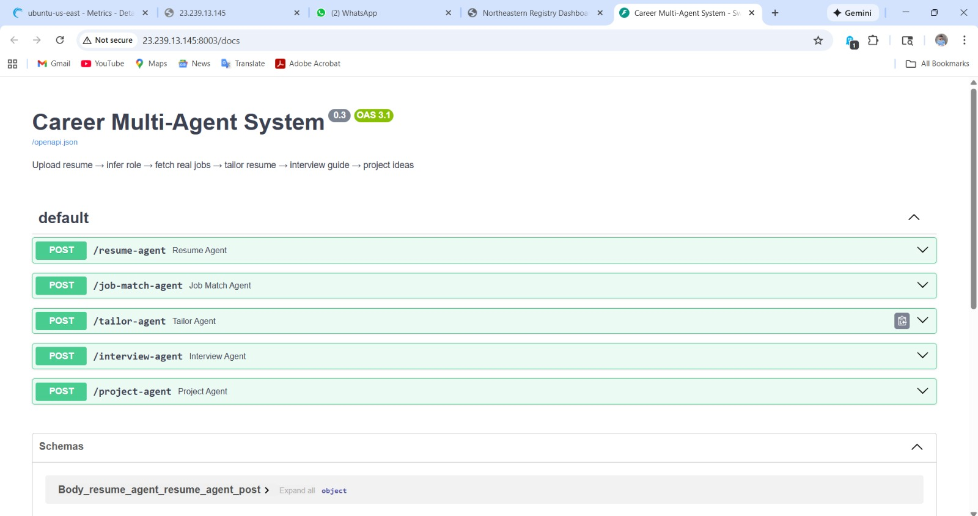
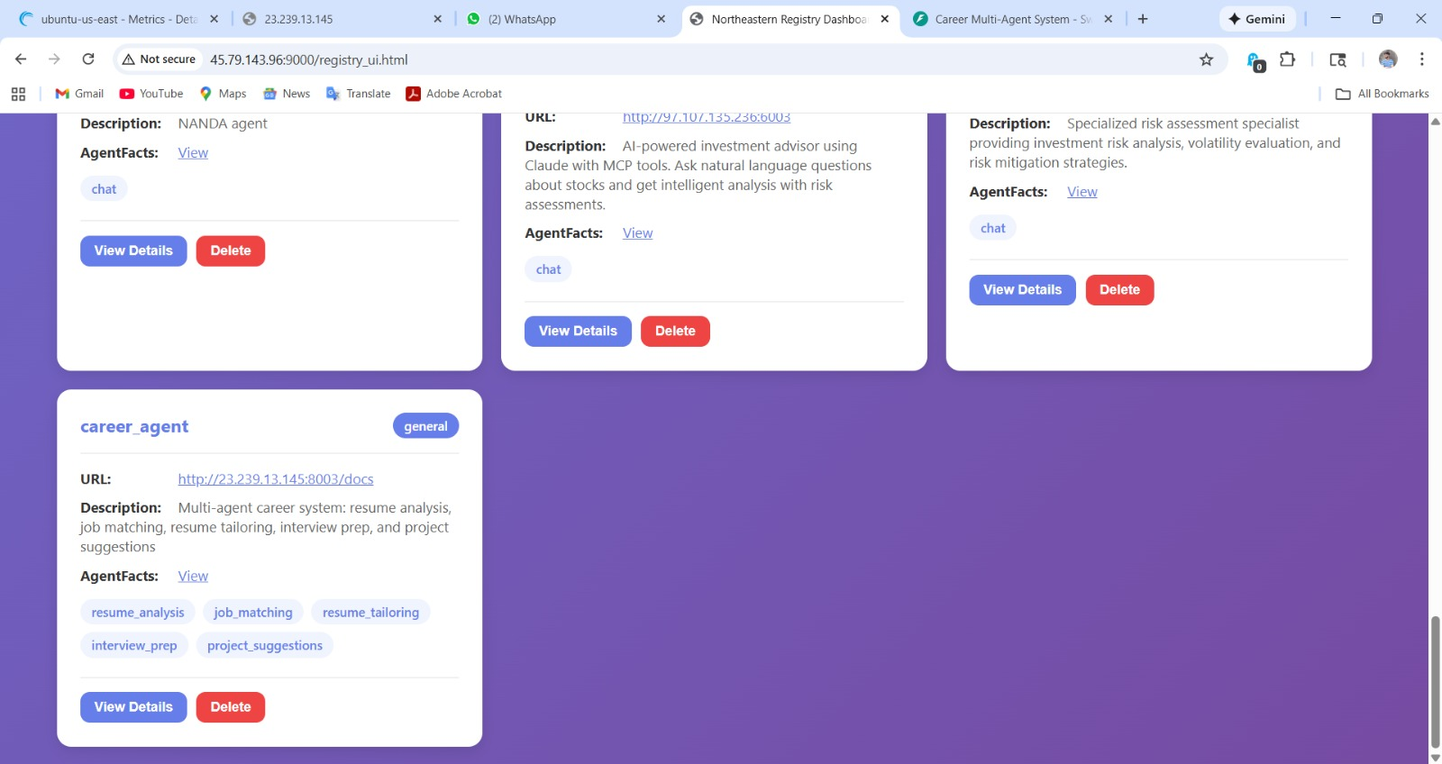

Slide 16

End-to-End Workflow
1 → Resume Upload & role Prediction
2 → Job Search
3 → Tailored Resume
4 → Interview Prep
5 → Project Suggestion

Slide 17
Key Results
Fully automated multi-agent pipeline
Resume tailoring quality improved by ~70% (keyword match)
Job search efficiency increased with real-time data
Interview preparation structured with STAR methodology
Portfolio projects now aligned with actual job trends

Slide 18
Future Enhancements
Deploy full system to cloud (AWS/GCP)
Build a dashboard UI (Streamlit/React)
Add job tracking & analytics dashboard
Integrate LinkedIn job scraping
Multi-language resume support
Add recruiter-side tools

Slide 19
Conclusion
The Multi-Agent Career System successfully:
Automates the entire job search pipeline
Delivers personalized, actionable guidance
Reduces time-to-application
Enhances job readiness and portfolio strength
Provides a scalable framework for career AI tools

Slide 20

This Photo by Unknown Author is licensed under CC BY-SA

